Slide 1
Final Team Project Milestone 3 Selected Machine Learning Algorithm: Convolutional Neural Network Super Classes: Vehicle 1 and Vehicle 2
Group 8: Aarathi Nadathur, Amar Ippili, Divya Puraswani, Sai Chaitanya Tolem, Sameer Rajput, Shubh Johri
CMPE257-Spring 2019

Slide 2
Dataset-CIFAR-100
The 100 classes in the CIFAR-100 are grouped into 20 super classes with 600 images in each class.
There are 500 training images and 100 testing images per class.
Each image comes with a "fine" label (the class to which it belongs) and a "coarse" label (the superclass to which it belongs).
Our goal is to perform a binary classification of images in vehicle 1 and vehicle 2 superclass pairs.
Superclass –vehicle 1
Class- bicycle, bus, motorcycle, pickup truck, train
vehicle 2
Class- rocket, tank, tractor, streetcar, lawn-mower

Slide 3
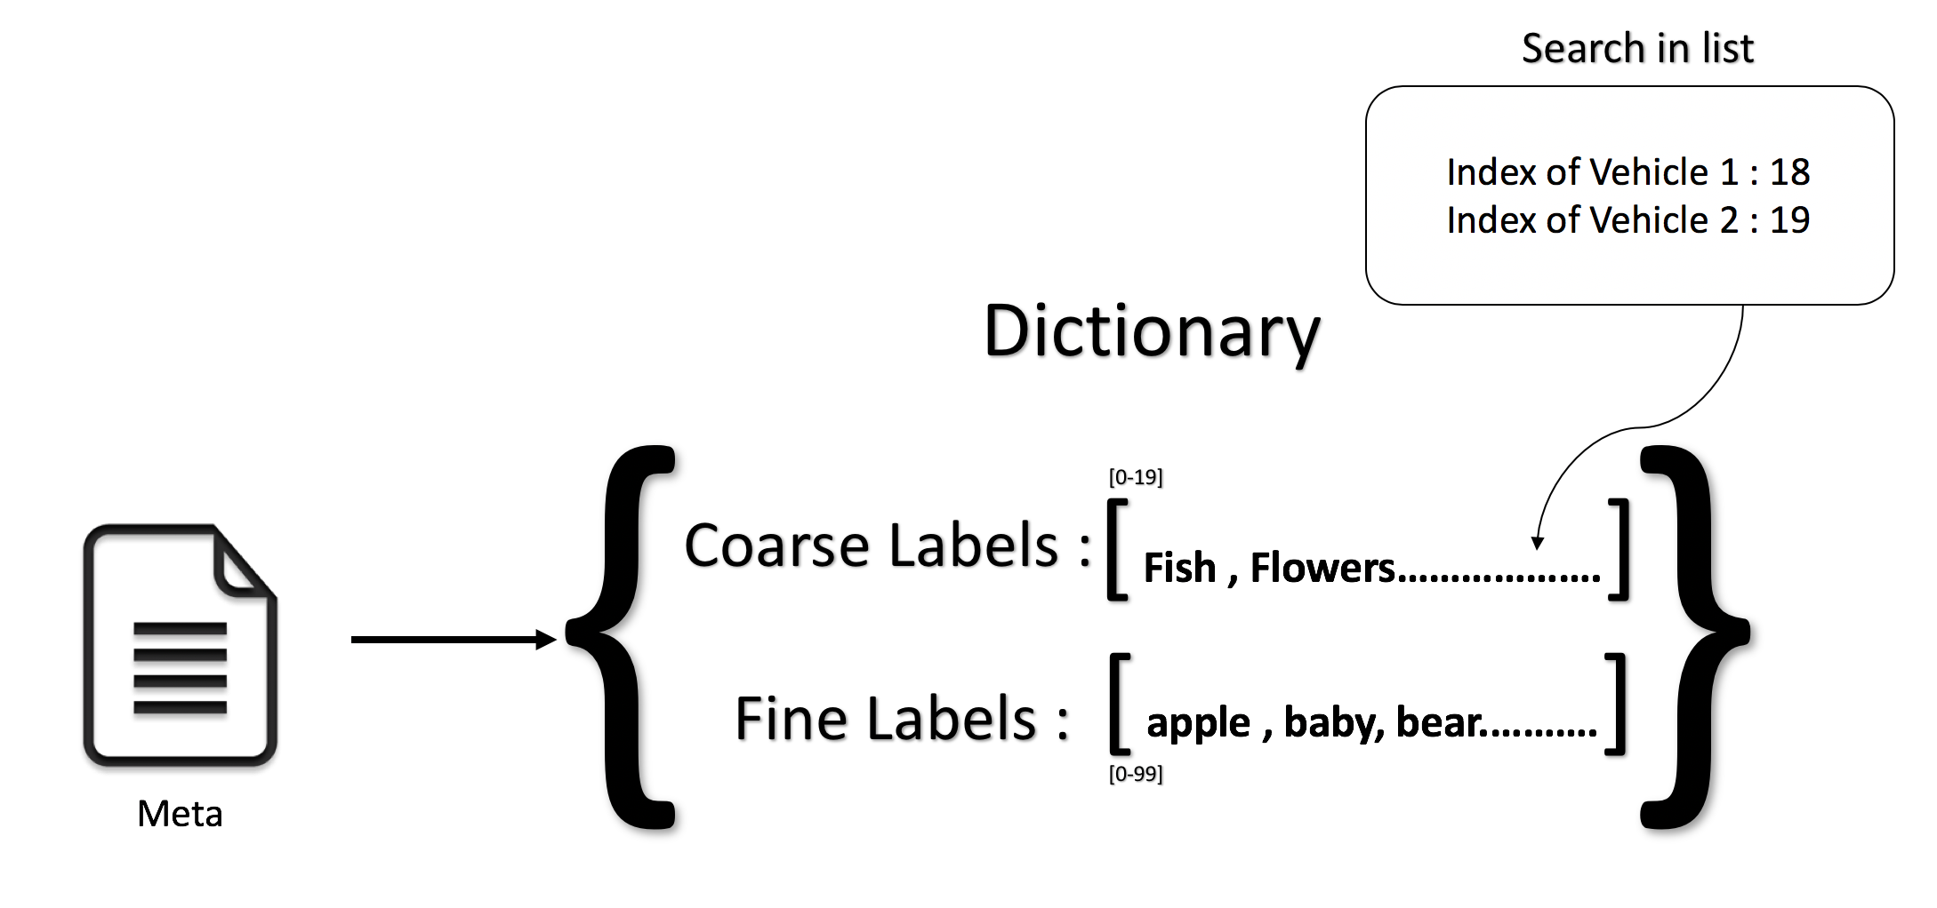
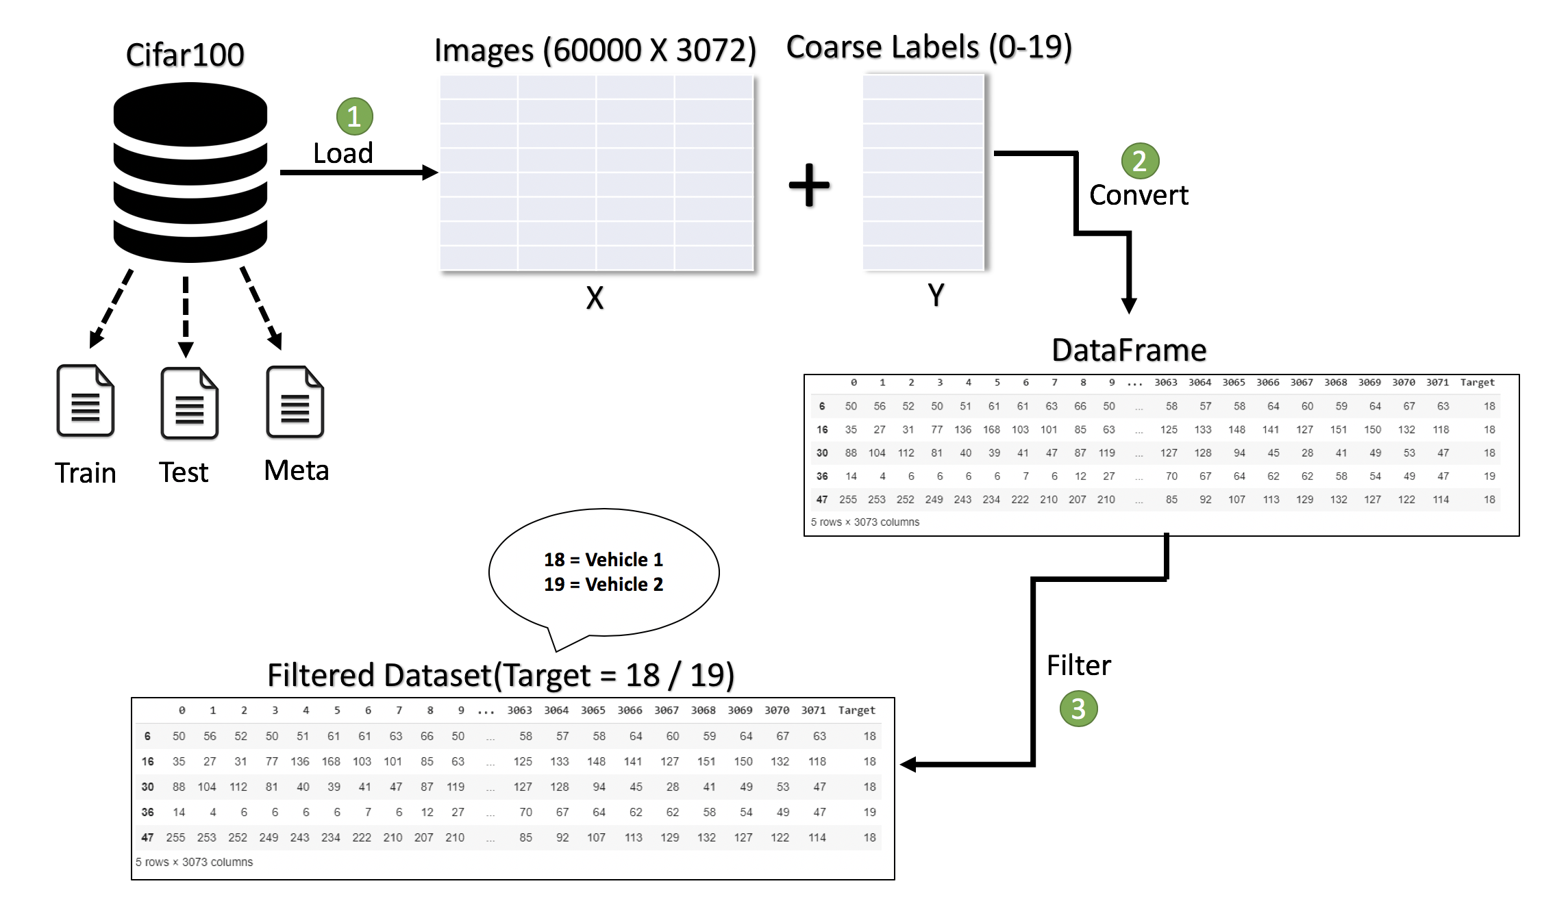
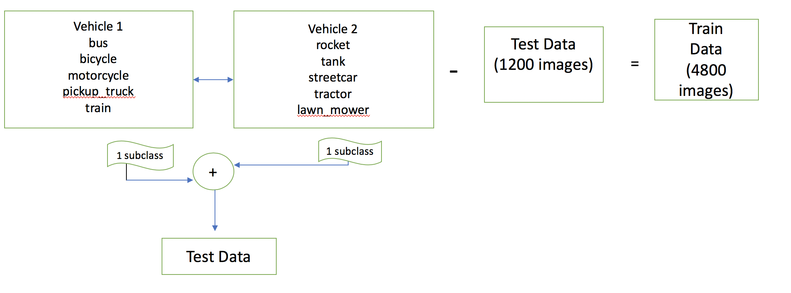
Data Preparation & Validation: Milestone 1 & Milestone 2
Milestone 1
Milestone 2

Slide 4
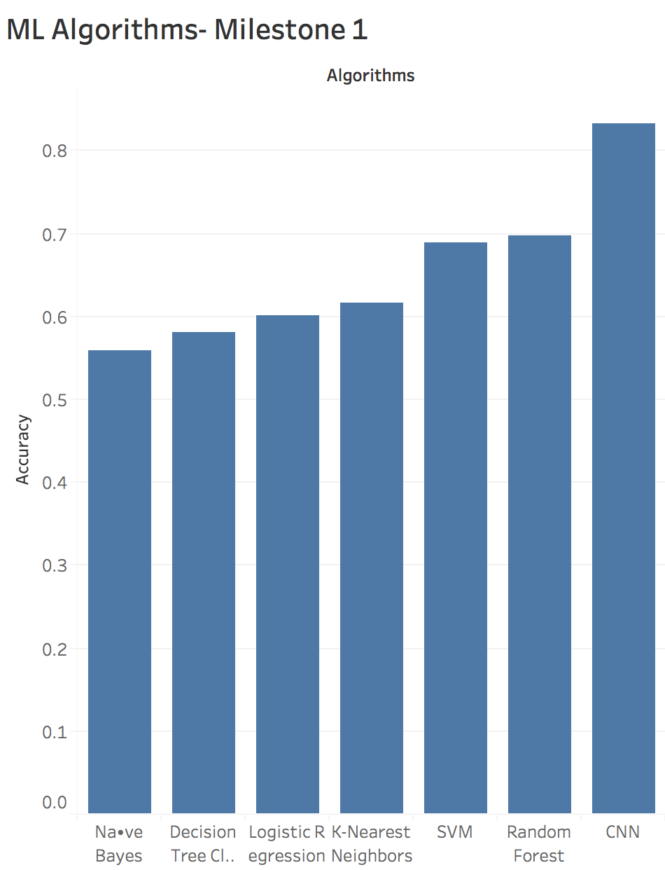
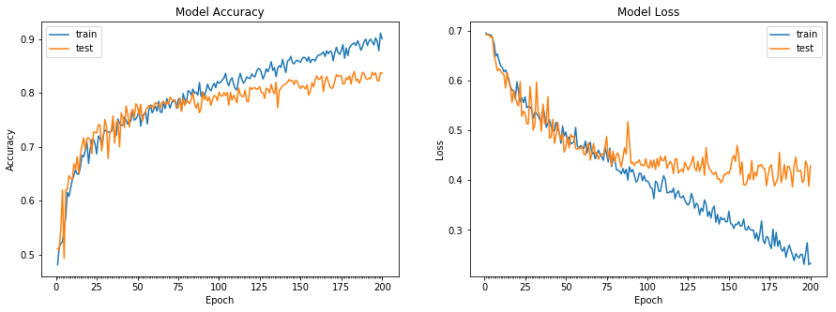
Machine Learning Algorithms Milestone 1
Best Model- CNN with 83.67%

Slide 5
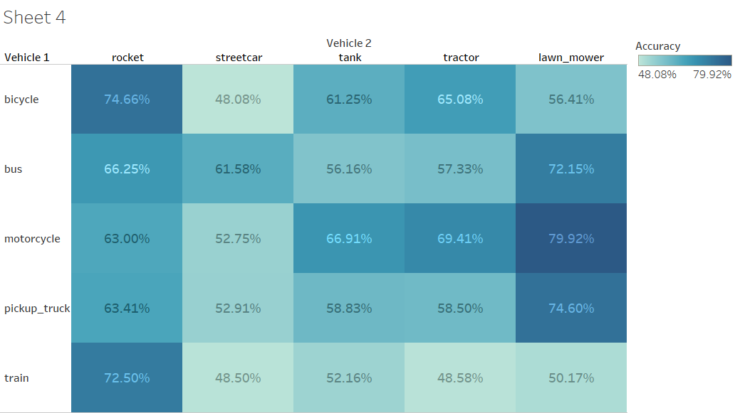
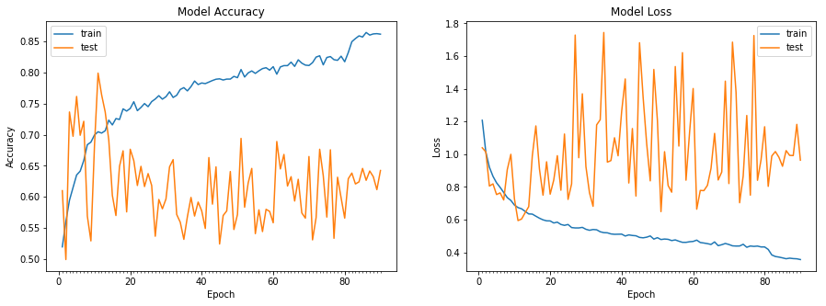
Machine Learning Algorithms Milestone 2
Best Model- Resnet(29) with 79.92%
Best Pair- motorcycle, lawn_mower

Slide 6
Selection Of Two Selected Sub- Classes from each Superclass as Testing Data.
Vehicle 1
bus
bicycle
motorcycle
pickup_truck
train
Vehicle 2
rocket
tank
streetcar
tractor
lawn_mower
Train
Data
(3600 images)
Test Data
(2400 images)
-
=
Motorcycle, Pickup Truck
2 subclass
2 subclass
Streetcar, Lawn_mower
+
Test Data

Slide 7
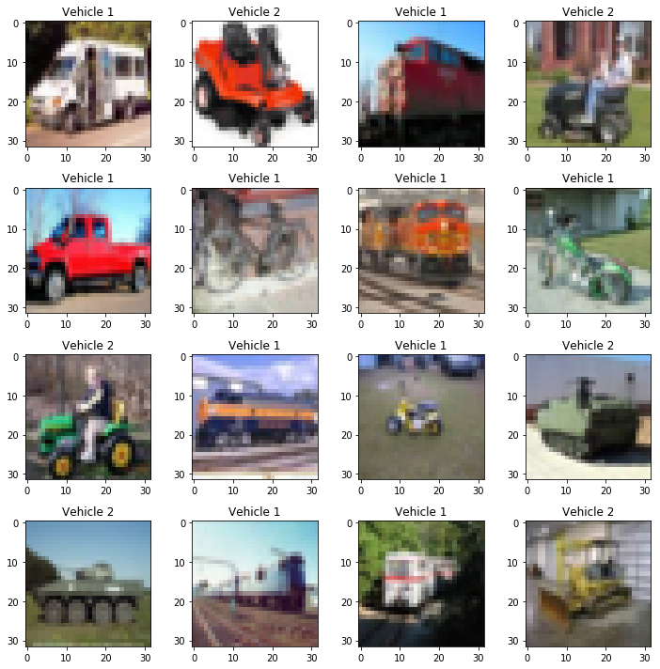
Validation of classes

Slide 8
Code Preparation
Permutations of Vehicle1/Vehicle2 – 20
Remove duplicate combinations – 10
Nested loops to run all combination pairs – 100
Code reusability with functions

Slide 9
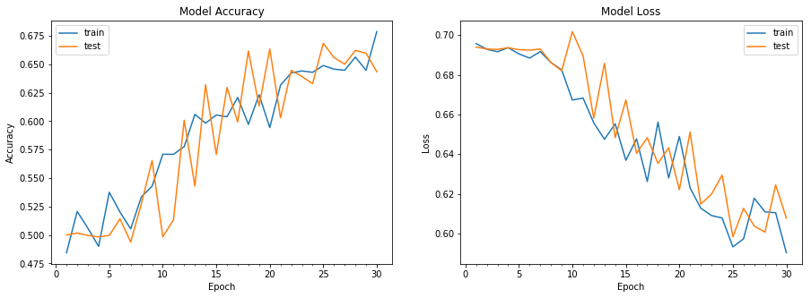
Selected Model-CNN
Best Pair(vehicle1): motorcycle, pickup truck
Best Pair(vehicle2): lawn_mower, streetcar
Number of epochs: 30
Learning rate: 0.00005
Batch size: 128
Trainable parameters: 66,76,610
Accuracy: 68.38%

Slide 10
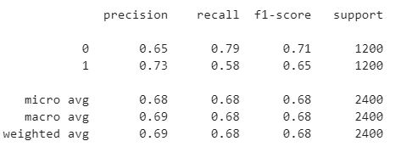
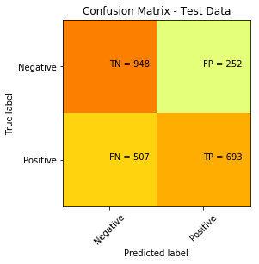
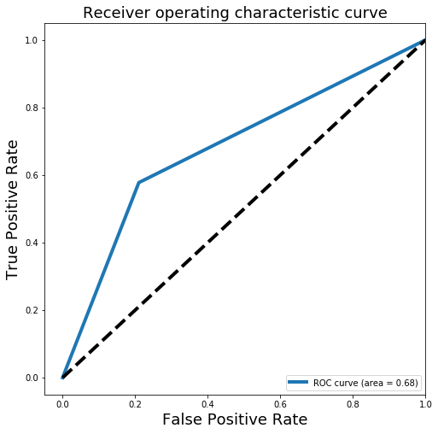
Confusion Matrix, Classification Report

Slide 11
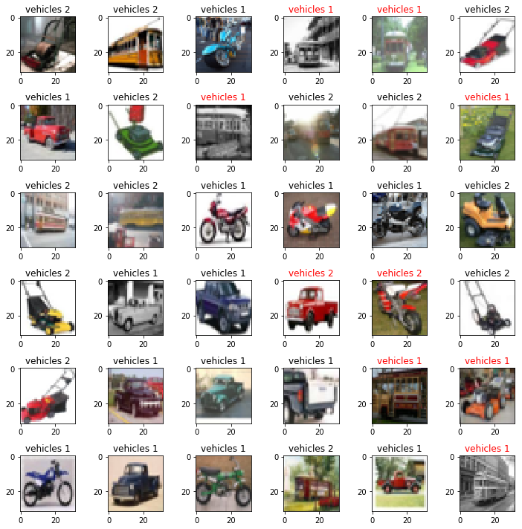
Output

Slide 12
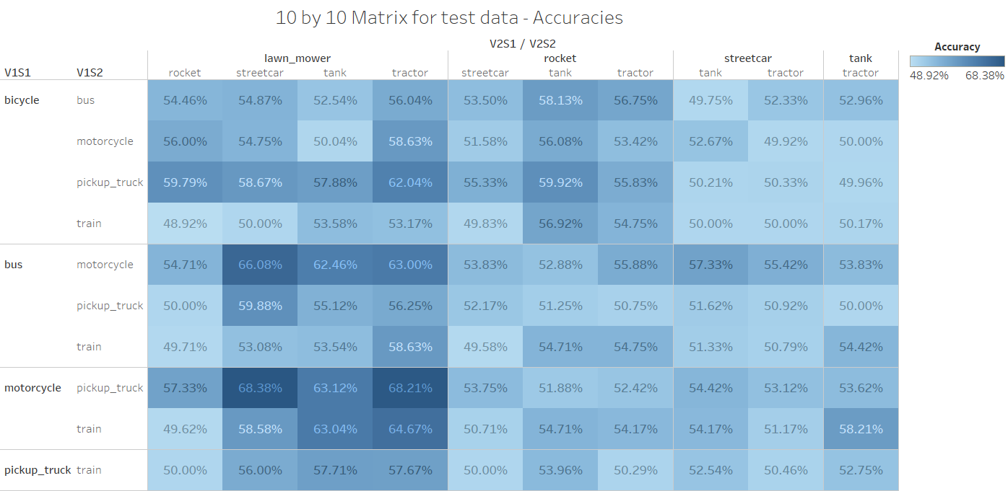
Summarization Chart (10X10)

Slide 13
Lessons Learned
Data Preprocessing plays an important role. - Normalization
CNN is better than all algorithms in terms of learning the features and flexibility to tune the hyperparameters
Dataset is balanced so Accuracy metric can be used as a standard to compare models
One model cannot perform well for all problem statements
Teamwork and Patience
Common pitfalls – Filtration, Looping CNN model for various combinations

